Slide 1

Predicting whether a book will receive a good rating
Students:
Iliya Belotherkovsky 336551502
Aviv Sharvit:208750042

Slide 2

Introduction
Although libraries are not as popular in the modern world today, there is still a demand and people who prefer to buy books and give their opinions on them. Therefore, we wondered if it is possible to predict the rating of a book that will be released under your name with the existing data we have today. And if a new book in a certain genre is released today, what are its chances of being as popular as Harry Potter was back then

Slide 3

Research Questions
The research question we are investigating is whether it is possible to predict the success of a book in achieving a high rating in relation to a website:
https://www.bookdepository.com/

Slide 4
The Process
Step 1
Data acquisition
(Selenium)
Step 4
Machine
Learning
Step 2
Data Handling
Step 3
EDA
Conclusion

Slide 5

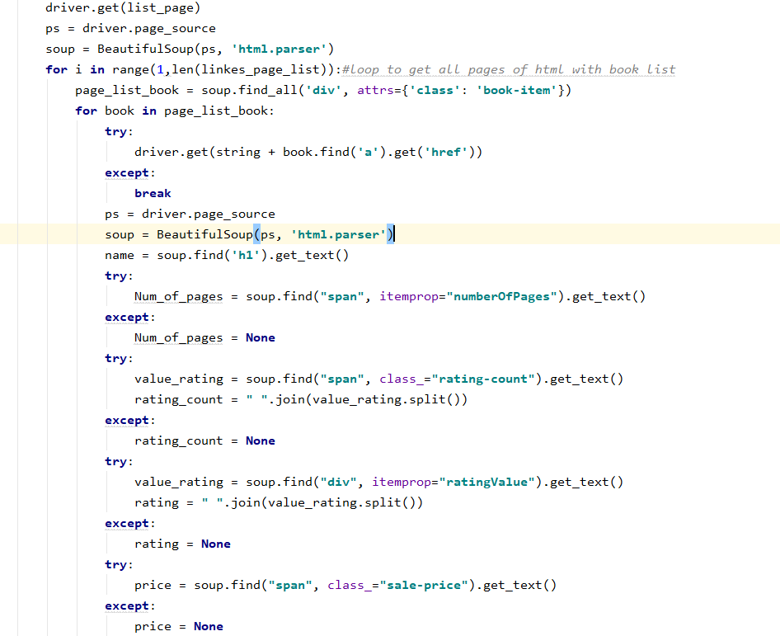
research source

Slide 6
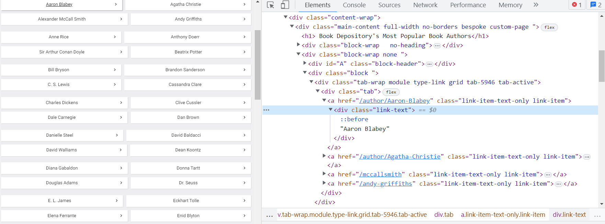
research source

Slide 7
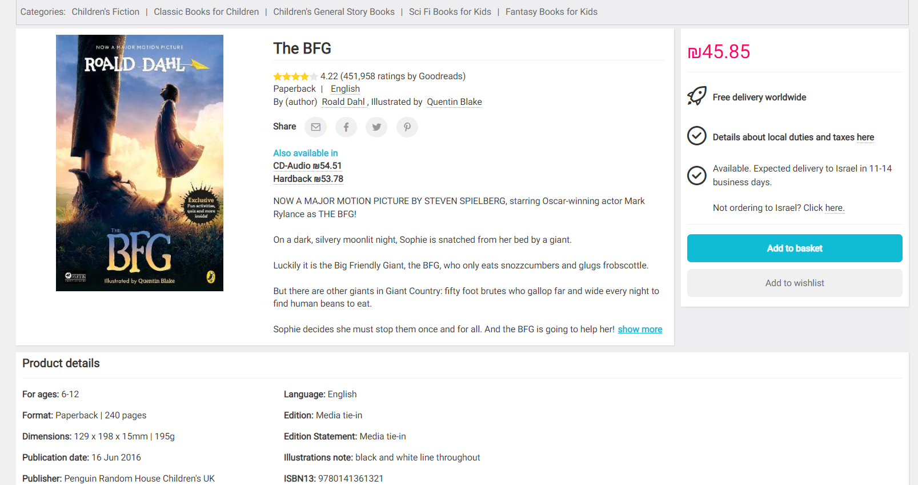
research source

Slide 8
Data Handling
During our work with the data, we followed the following steps:
1. We merged two files and changed their format from row display to column display.
2 We removed rows from the data that contained missing information.
3. We downloaded compressed versions of the data.
4. We removed currency symbols from the prices.
5. We downloaded all the books that received less than 200 ratings.
6. We downloaded the genre that appeared multiple times.

Slide 9
EDA
During the execution of graph tags, we tried to identify a linear correlation between the columns, therefore we used the following shapes:
1 Bar plot
2 Pie plot
3 Box plot
4 Hist plot
5 Violin box plot
6 Pair plot

Slide 10
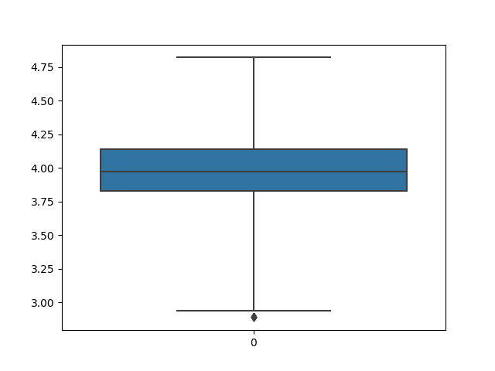
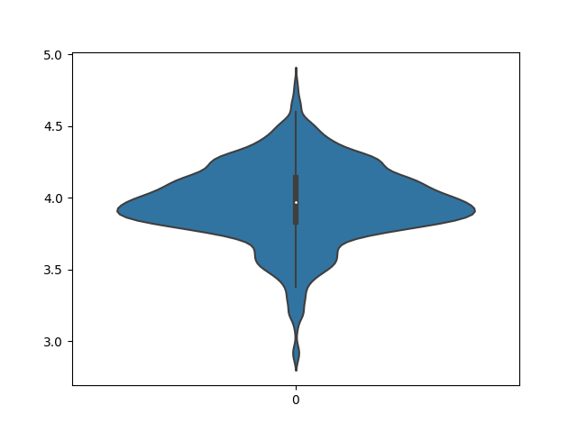
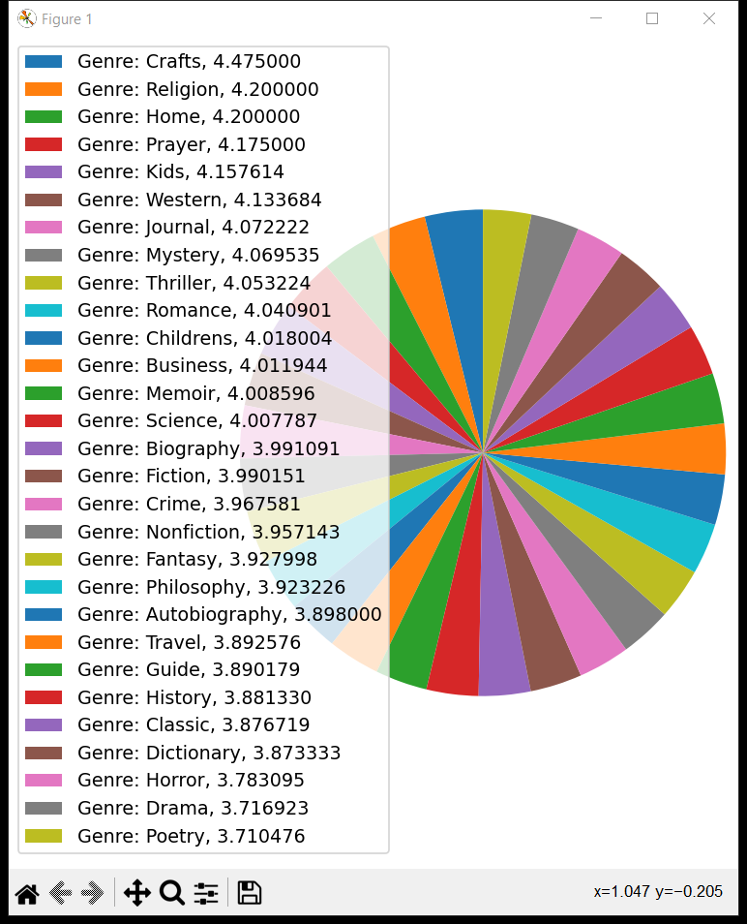
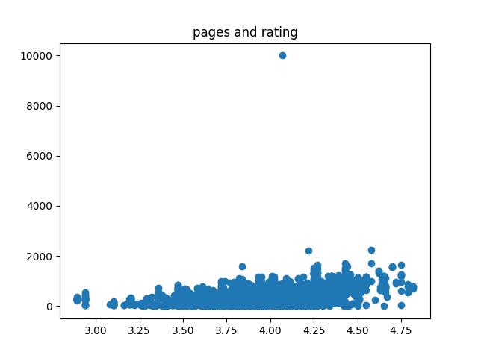
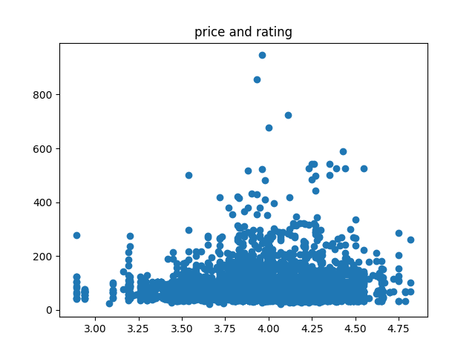

Slide 11
Machine Learning
We employed a supervised method in the machine learning phase
All of the numeric columns were included in the feature vector x, except for the successful and score column (successful is the goal column y)
We untilized logistic regression to train the model, which is designed for binary problems (in our instance ,0/1)
The accuracy of the prediction was impressive 88%
We divided the data frame into training and testing model as well.
Our major strategy to use logistic regression, which yielded an accuracy of 89%

Slide 12
Conclusion
Despite achieving solid results in learning the machine, we have reached a predicament where the success of the book cannot truly be predicted, as it depends solely on its content.

Slide 13


